Slide 1

BEGINNER TO EXPERT GUARANTEED
RED HAT LINUX COURSE
ACCESS MORE COURSES PLAYLIST LINK IN DESCRIPTION
SUBSCRIBE!!!

Slide 2

TOPICS
Introduction to Red hat LINUX
Downloading & Installing RED Hat
Understanding RED Hat Linux interface
Basic commands and operations
File management from command line
managing RED hat local users & groups
Red hat file permission system
How to install packages in Linux
Create & managing lvm in red hat
installing & managing openssh in red hat
syslog server in red hat Linux
soft link & hard link in red hat
red hat virtualization system

Slide 3
Introduction to Red hat Linux

Slide 4

Red Hat Linux?
Today, Red Hat Enterprise Linux supports and powers software and technologies for automation, cloud, containers, middleware, storage, application development, microservices, virtualization, management, and more. Linux plays a major role as the core of many of Red Hat's offerings.

Slide 5
Advantages:
It is designed to be easy to use.
Because of its Secure Design
Long Last Support System and Scalability
Lots of Service Support
Best in Subscription
It grows Stronger Day by Day
Disadvantages:
Not Designed for Remote Management
RHEL UI is not so Friendly
Cost sometimes high for low use
High Hardware Recommendations.

Slide 6
Certifications
Red Hat Certified System Administrator (RHCSA)
Red Hat Certified Engineer (RHCE)
Red Hat Certified Architect (RHCA)
Job Opportunities
Linux System Administrators
System Administrators
Senior Systems Administrators
Associate Technical Support Engineer
Lead infrastructure engineer

Slide 7
2. Downloading & Installing RHEL

Slide 8
Let’s Get Started

Slide 9
3. Understanding RHEL Interface

Slide 10
Let’s Get Started

Slide 11
4. Basic Commands and Operations

Slide 12
Let’s Get Started

Slide 13
5. File Management from Command Line

Slide 14
Let’s Get Started

Slide 15
6. Managing RED HAT Local Users & Groups

Slide 16
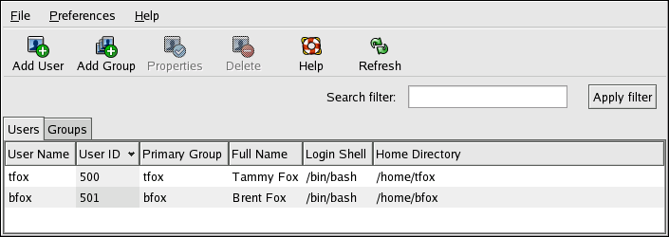
Users & Groups
Users and groups are used on GNU/Linux for access control—that is, to control access to the system's files, directories, and peripherals. Linux offers relatively simple/coarse access control mechanisms by default.

Slide 17
Types of Users

Slide 18
Let’s Verify it!

Slide 19
7. RED HAT File Permissions System

Slide 20
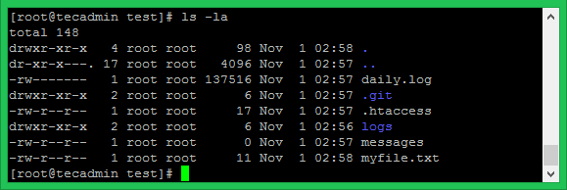
Files Permissions
On a Linux system, each file and directory is assigned access rights for the owner of the file, the members of a group of related users, and everybody else. Rights can be assigned to read a file, to write a file, and to execute a file (i.e., run the file as a program).

Slide 21
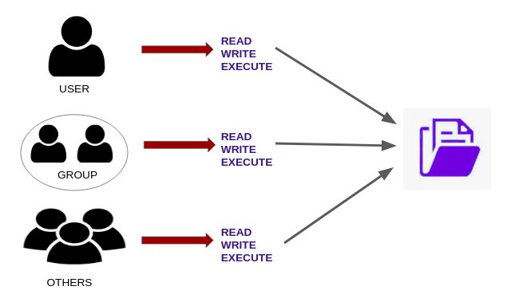
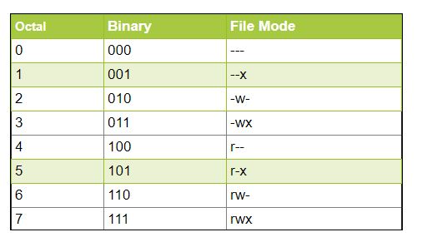

Slide 22
8. How to Install Packages in Linux

Slide 23
Packages ???

Slide 24
Let’s Try it!

Slide 25
9. Create & Managing LVM in RED HAT

Slide 26
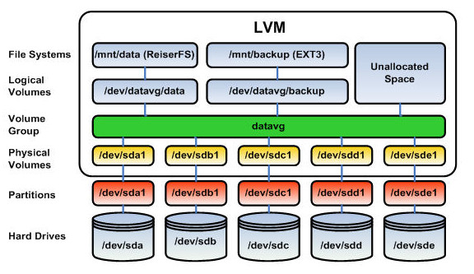
LVM ???
LVM is a tool for logical volume management which includes allocating disks, striping, mirroring and resizing logical volumes. With LVM, a hard drive or set of hard drives is allocated to one or more physical volumes. LVM physical volumes can be placed on other block devices which might span two or more disks.

Slide 27
Let’s Try it!

Slide 28
10. Installing & Managing OPENSSH in RED HAT

Slide 29

OPENSSH ???
OpenSSH is a freely available version of the Secure Shell (SSH) protocol family of tools for remotely controlling, or transferring files between, computers. Traditional tools used to accomplish these functions, such as telnet or rcp, are insecure and transmit the user's password in cleartext when used.

Slide 30
Let’s Try it!

Slide 31
11. Syslog Server in RED HAT Linux

Slide 32

SYSLOG ???
The syslog server on a Linux machine can act a central monitoring point over a network where all servers, network devices, routers, switches and most of their internal services that generate logs, whether related to specific internal issue or just informative messages can send their logs.

Slide 33
Let’s Try it!

Slide 34
12. Soft Link & Hard Link in Kali Linux

Slide 35
SOFT vs HARD LINK ???

Slide 36
Let’s Try it!

Slide 37
13. RED HAT Virtualization System

Slide 38
VIRTUALIZATION???

Slide 39
Let’s Try it!

Slide 40

Hope Guys You got the point of the Video

